Slide 1
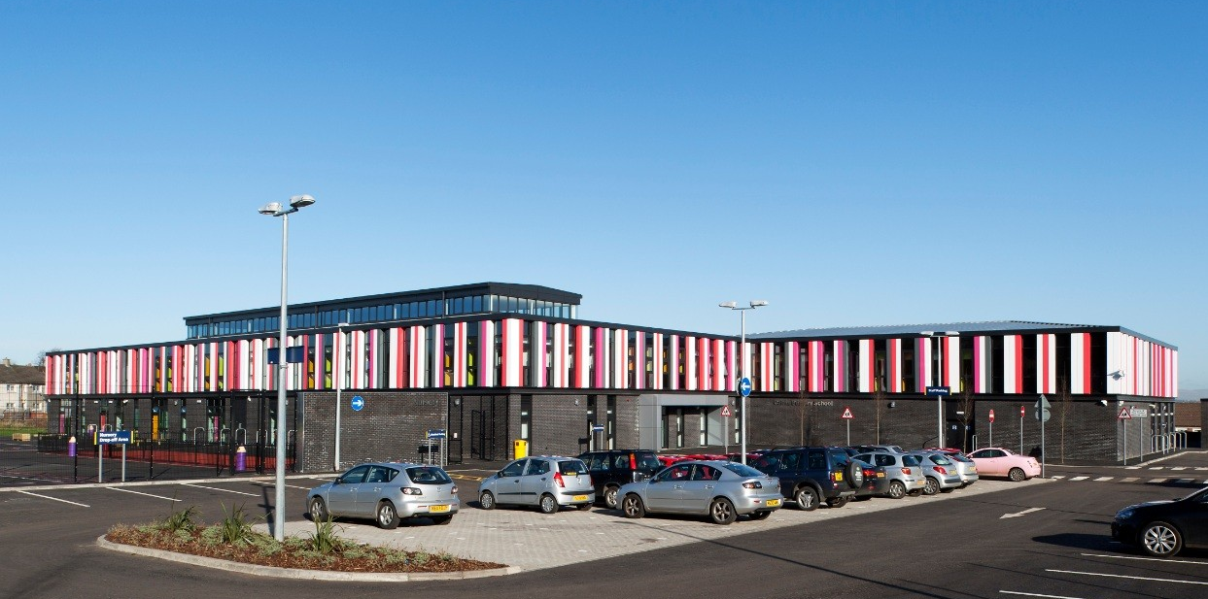
Cairns Primary School

Slide 2
Downloading the App
Scan the QR code on the leaflet to go directly to the AppStore or Google Play Store
Go to AppStore or Google Play Store and search for ‘PSA Primary School App’
Once you have opened the app, search for ‘Cairns Primary School’

Slide 3
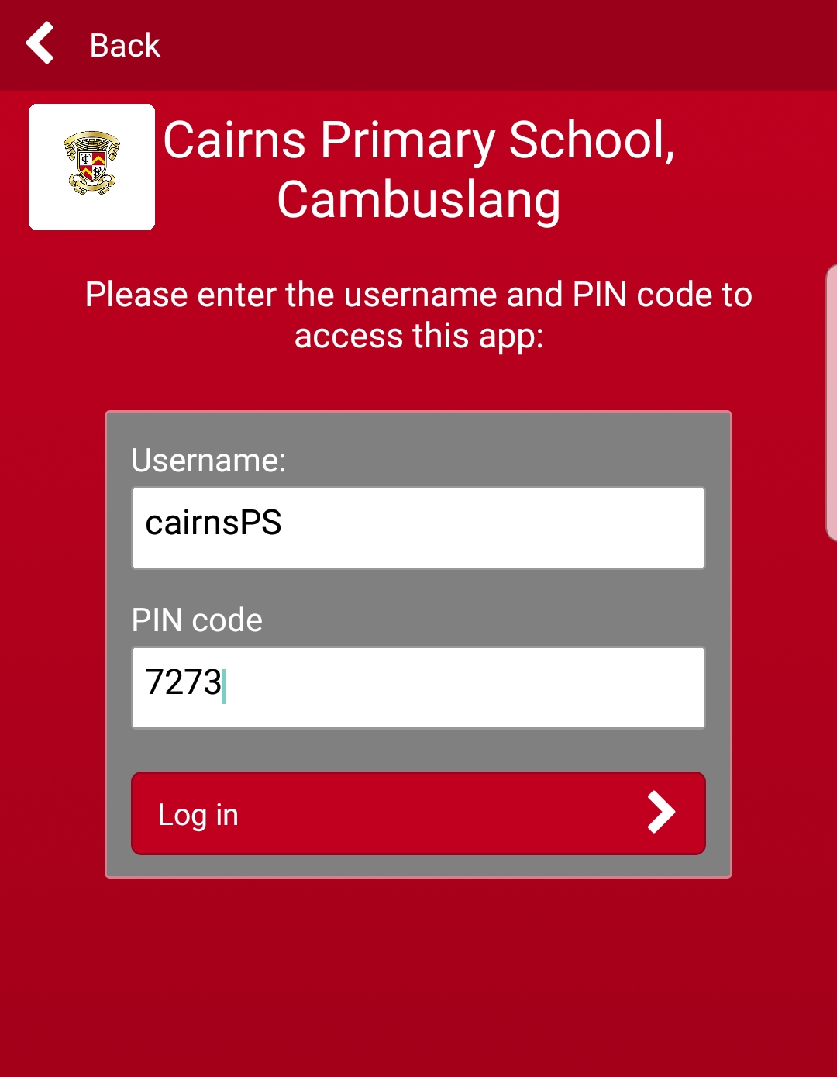
Logging in

Slide 4
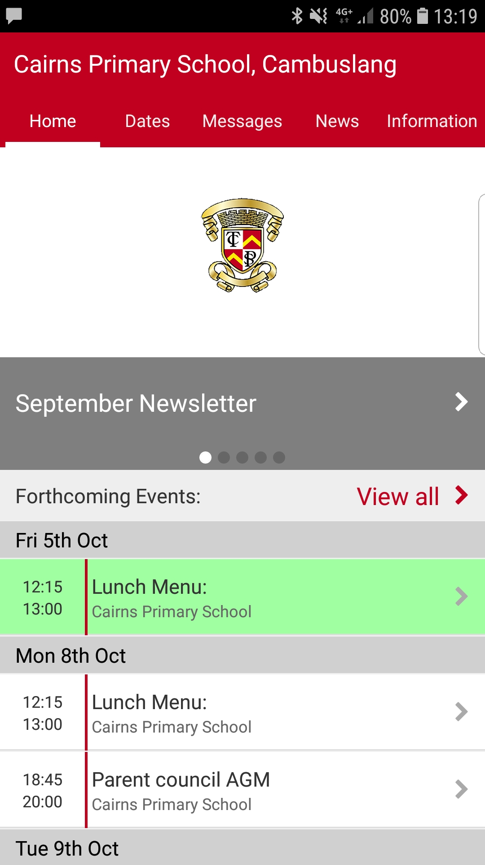
The Homepage
Menu tabs
Access to latest news
Upcoming events

Slide 5
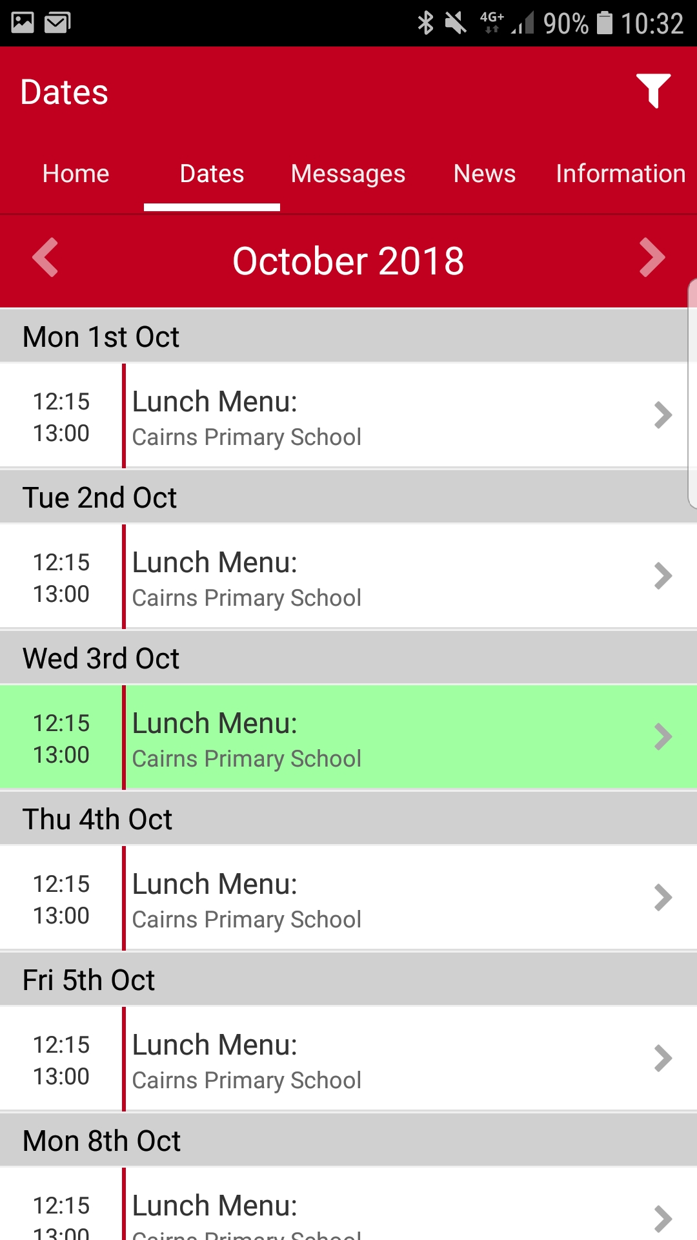
Dates
Access to school calendar
Daily lunch menu
Click entries for more info
Scroll across for next month

Slide 6
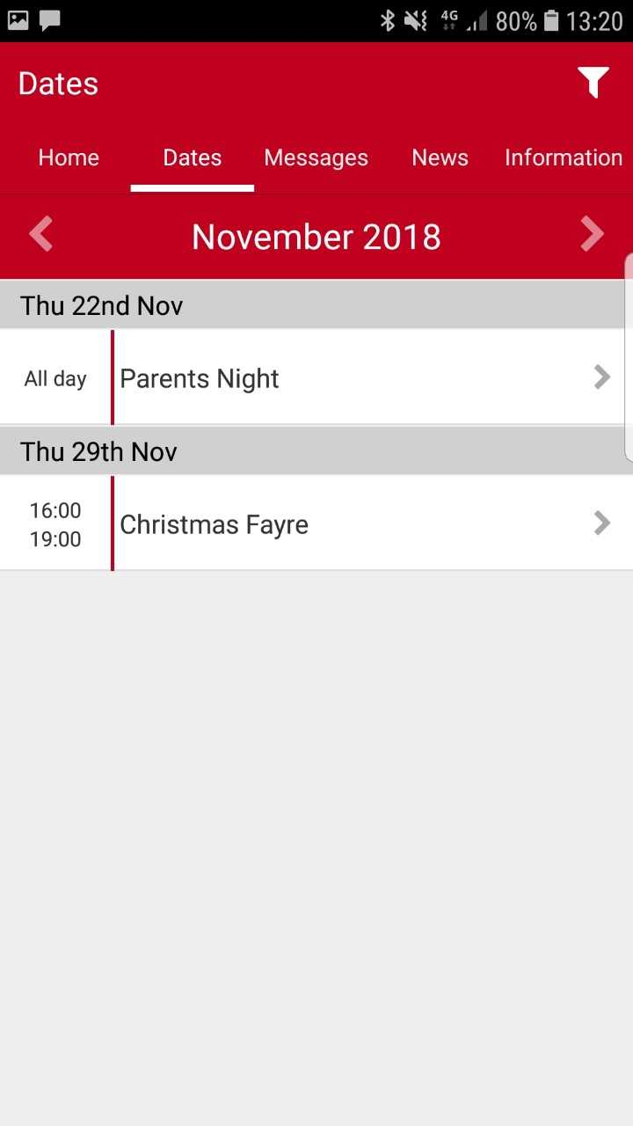
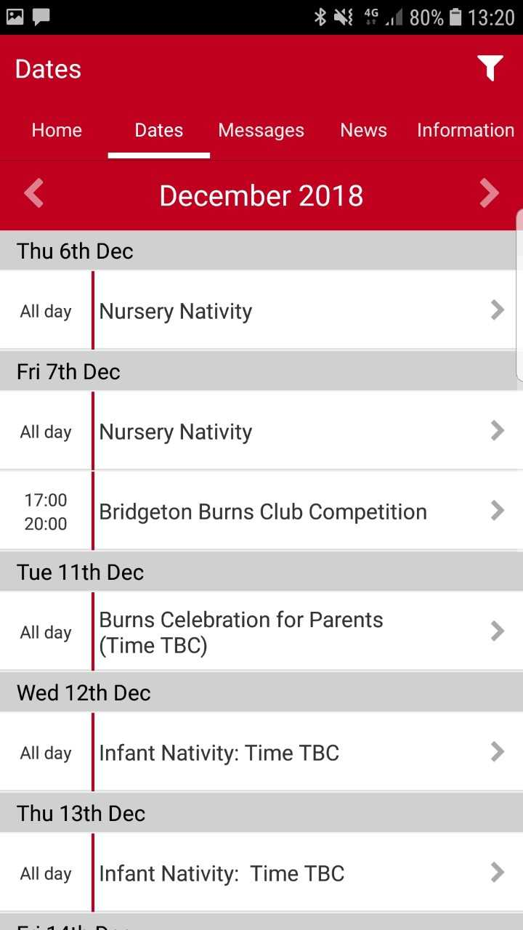
Dates

Slide 7
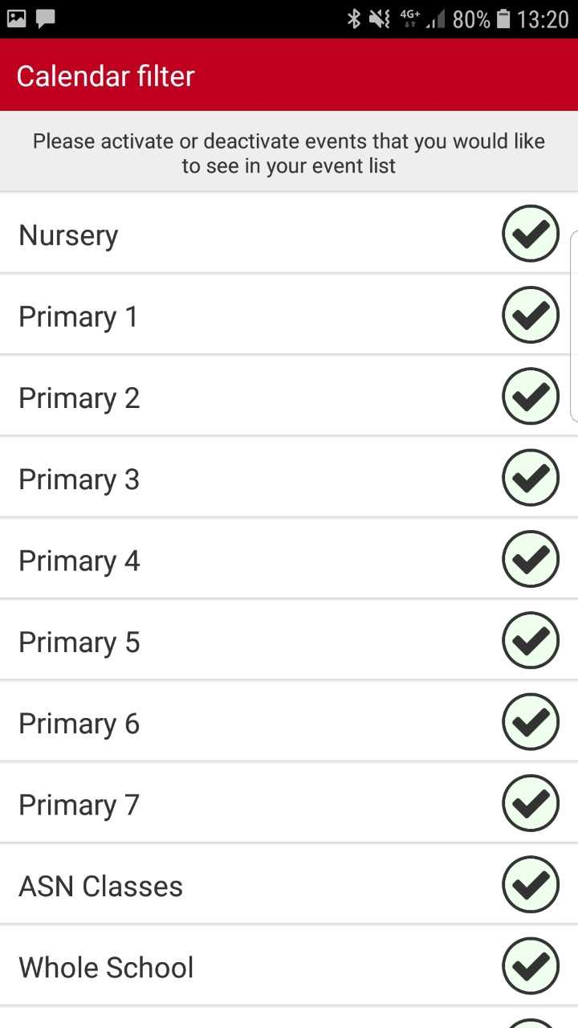
Filtering Dates
Choose what you want to see
Choose whole school, your child’s stage and either ‘Infants’, ‘Juniors’ or ‘Seniors’
Choose ‘Catering’ if you want to see lunches
Default setting is to see all events

Slide 8
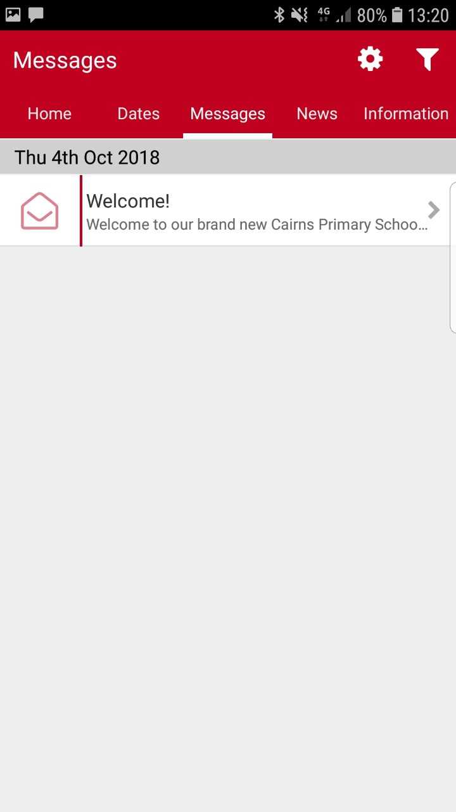
Messages
Messages and alerts sent out by the school
Notification pop-ups
Filter system as before
Choose your relevant departments
Settings cog allows you to mark as read/delete

Slide 9
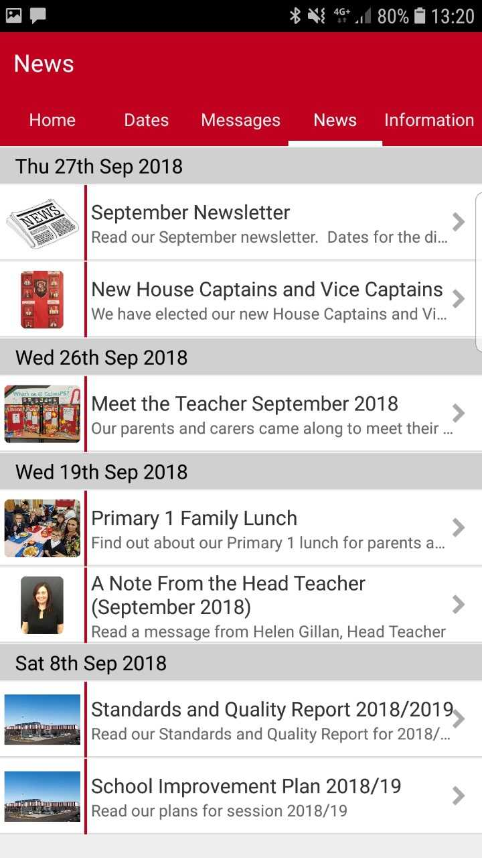
News
Reports on latest news in school
Click on each story to learn more
Link to website or link for downloading a document
Keeping up to date with events/developments

Slide 10
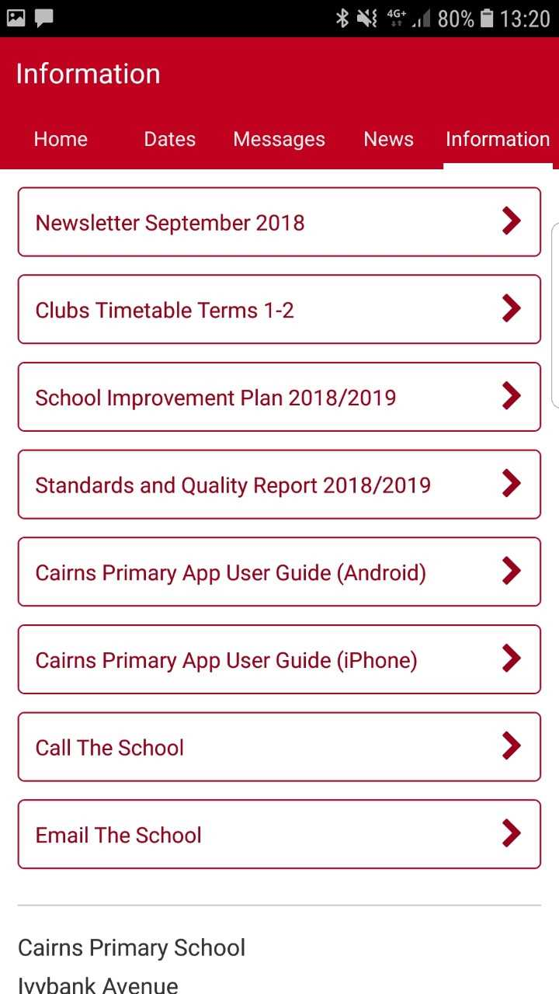
Information
Links to important documents e.g. School Improvement Plan
Latest newsletters
User guides for the app
Clubs Programme
Contact details for school

Slide 11
Enjoy the App!
Hope it will be useful!
Share the login details
Comments/suggestions – what’s missing?

